Slide 1

DETECTION OF PHISHING USING MACHINE LEARNING
BY : ELAMATHI.R JEPPIAAR INSITUTE OF TECHNOLOGY ARTIFICIAL INTELLIGENCE & DATA SCIENCE

Slide 2
CONTENTS
Problem Statement
Proposed System/Solution
System Development Approach (Technology Used)
Algorithm & Deployment
Result (Output Image)
Conclusion
Future Scope
References

Slide 3
PROBLEM STATEMENT
This project aims to combat phishing attacks by training machine learning models and deep neural networks on a dataset comprising both phishing and benign URLs. Extracting pertinent features from these URLs and website contents, the models will be evaluated for their ability to accurately predict phishing websites. The project seeks to identify the most effective approach for enhancing cybersecurity and safeguarding users against malicious online activities.

Slide 4

PROPOSED APPROACH
Collection of Data
Split the Data Into Train and Test set
Build The Model
Train the Model
Deploy The Model
Results
Import Links To Prediction

Slide 5
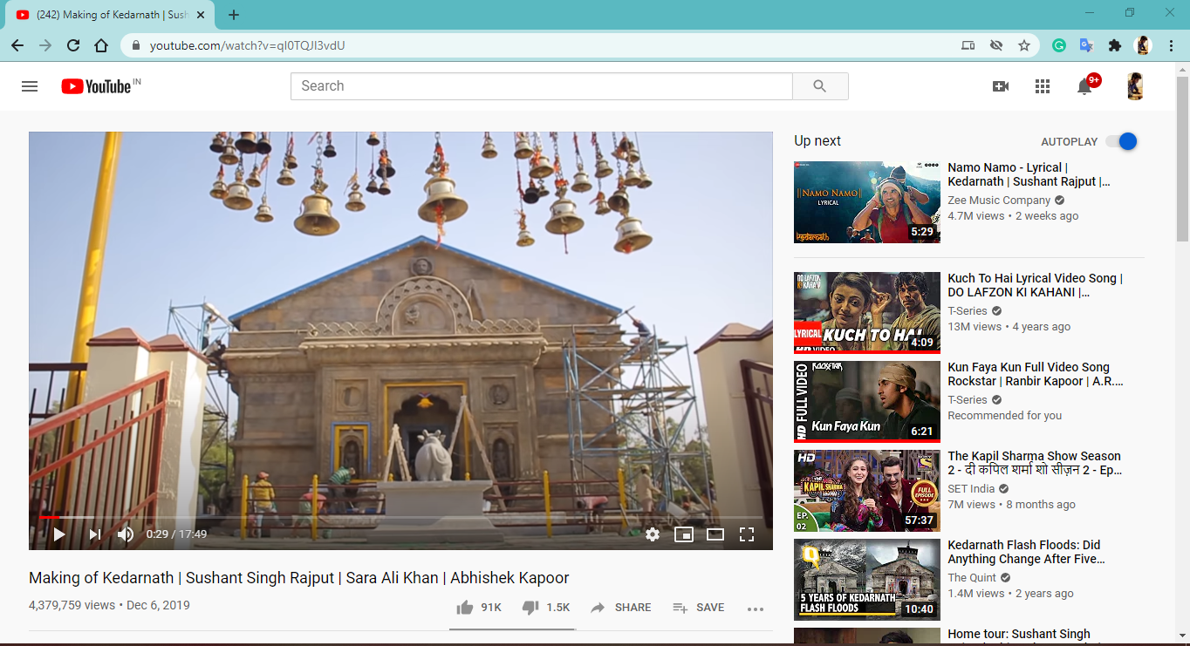
PROJECT OVERVIEW
Target Label
Phishing site
Not Phishing Site
Classifier
Training links
Testing links

Slide 6
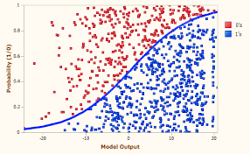
PROJECT OVERVIEW (HOW IT ACTUALLY WORKS)
Pulling
Converting
Fit data
Tokenizes
Transforms
text
Results

Slide 7
SYSTEM APPROACH
Hardware | Processor: Minimum Intel Core i5 or equivalent
 | RAM: 8 GB
 | Storage: 256 GB SSD or higher
Software | Operating System: Windows 10, macOS 10.15, Ubuntu 20.04 LTS
 | Programming Language: Python 3.8 or higher

Slide 8
LIBRARIES USED
Pandas | RegexpTokenizer
Numpy | SnowballStemmer
Seaborn | CountVectorizer
Matplotlib | make_pipeline
Plotly | Image
Time | Word cloud
LogisticRegression | Beautiful Soup
MultinomialNB | selenium
train_test_split | NetworkX
classification_report | Warnings
confusion_matrix

Slide 9
ALGORITHM AND DEPLOYMENT
Data Collection:
Gather a dataset of URLs known to be phishing sites as well as legitimate sites. An example dataset, phishing_site_urls.csv, contains URLs labeled as 'bad' for phishing and 'good' for legitimate.
Preprocessing:
Tokenize URLs to separate important keywords using regular expressions.
Apply stemming to reduce words to their root form, enabling the model to generalize better across similar terms.
Feature Extraction:
Utilize CountVectorizer to transform the preprocessed URLs into a sparse matrix of token counts. This step turns textual data into numerical data, preparing it for machine learning models.
Model Selection and Training:
Split the dataset into training and testing sets to validate the effectiveness of the model.
Implement and compare two machine learning models: Logistic Regression and MultinomialNB (Naive Bayes), to predict whether a URL is a phishing site or legitimate.
Model Evaluation:
Evaluate the models' performance on the test set using accuracy score, confusion matrix, and a detailed classification report.
Selection of Best Model:
Choose the model with the best predictive accuracy. In this case, Logistic Regression showed superior performance.
Deployment:
Implement the chosen model into a pipeline, using CountVectorizer for feature extraction and the selected algorithm for classification. This pipeline streamlines the process from raw input to prediction.

Slide 10
RESULT
The algorithm shows a very high degree of accuracy in detecting phishing URLs, with the Logistic Regression model achieving an impressive 98% accuracy in testing. This suggests that the model has successfully learned to distinguish between phishing and legitimate URLs.

Slide 11
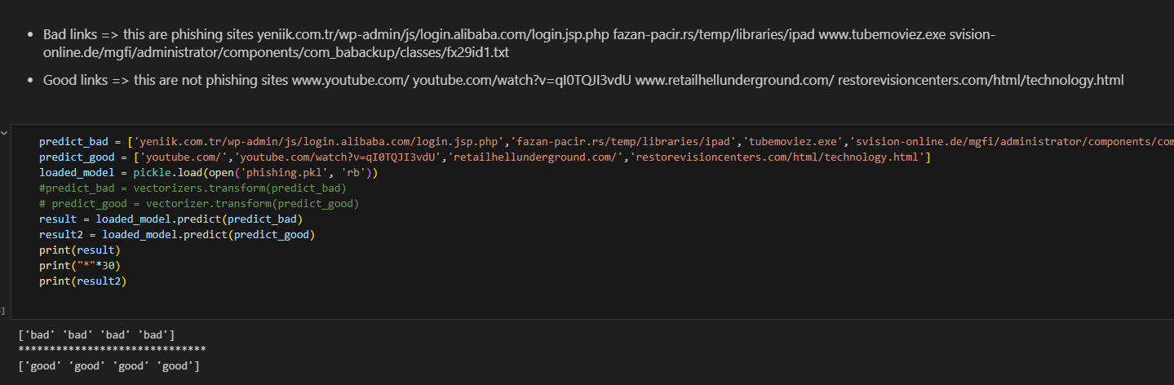
OUTPUT SCREENSHOT

Slide 12
CONCLUSION
The algorithm's effectiveness emphasises the power and potential of machine learning and NLP in cybersecurity. It appears that, by using a combination of tokenization, stemming, and machine learning models, we can quickly identify potentially harmful URLs and protect users with considerable reliability.

Slide 13
FUTURE SCOPE
Application Deployment: This model could be integrated into systems that scan or monitor network traffic, providing real-time phishing detection to individuals or businesses.
Model Improvement: Although the current model's accuracy is quite high, further optimisation is possible. This could be achieved by trying out different algorithms, improvising preprocessing steps or tuning hyperparameters.
Extend Phishing Detection Scope: Phishing is now present not just in URLs but also in emails, messages, and social media. The same concept can be expanded to identify these threats.
Real-Time Learning: If a steady stream of new data could be secured, the model could continually learn and adapt to new strategies used by phishers.
Phishing Classification: In addition to binary classification (phishing vs. legitimate), we could attempt multiclass classification. For instance, categorize URLs by phishing strategy, such as deceptive phishing, spear phishing, or pharming.

Slide 14
REFRENCES
https://archive.ics.uci.edu/ml/datasets/Phishing+Websites
https://github.com/shreyagopal/Phishing-Website-Detection-by-Machine-Learning-Technique
https://www.ncbi.nlm.nih.gov/pmc/articles/PMC8504731/ s/blob/master/URL%20Feature%20Extraction.ipynb
https://ieeexplore.ieee.org/document/9824801
https://arxiv.org/pdf/2201.10752

